Slide 1




Debugging and Troubleshooting Code
Finding and Fixing Bugs in Programs
Debugging
SoftUni Team
Technical Trainers
Software University
http://softuni.bg

Slide 2

Table of Contents
Program Execution Flow
Debugging
Debug Windows
Debugging Code
Breakpoints
Data Inspection

Slide 3
Questions?
sli.do #fund-softuni

Slide 4
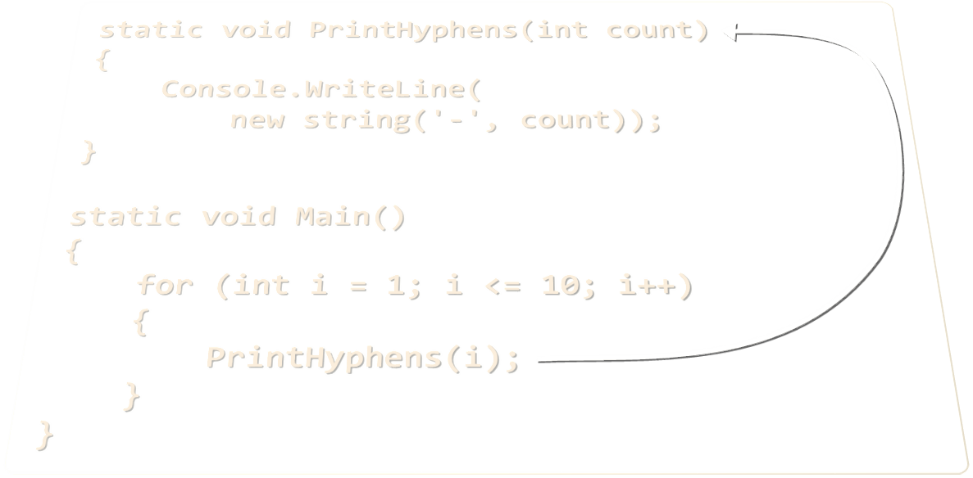
Program Execution Flow

Slide 5
Program Execution
The program continues, after a method execution completes:
Executes first
static void Main()
{
Console.WriteLine("before method executes");
PrintLogo();
Console.WriteLine("after method executes");
}
Method call
Executes last
static void PrintLogo()
{
Console.WriteLine("Company Logo");
Console.WriteLine("http://www.companywebsite.com");
}

Slide 6


Program Execution – Call Stack
"The stack" stores information about the active subroutines (methods) of a computer program
Keeps track of the point to which each active subroutine should return control when it finishes executing
Call Stack
call
call
Main
Method A
Main
Method A
Method B
START
Method B
return
return

Slide 7
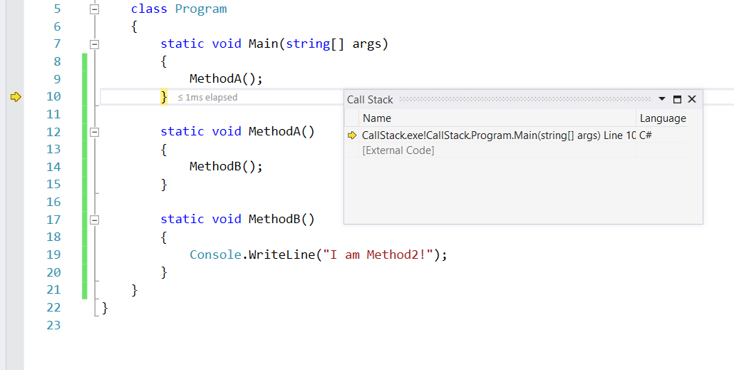
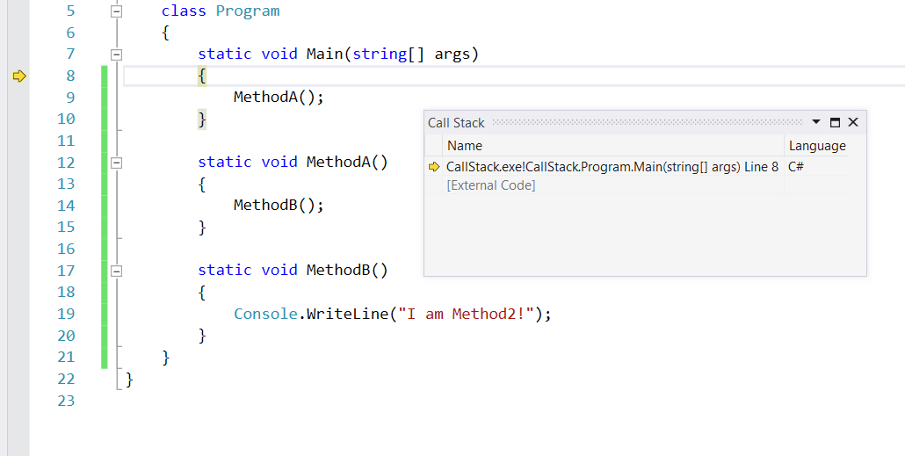
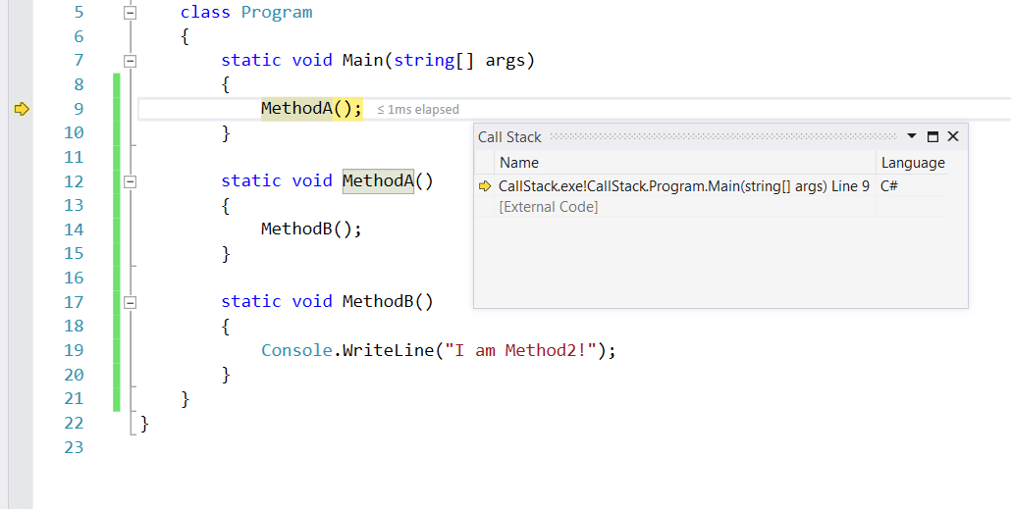
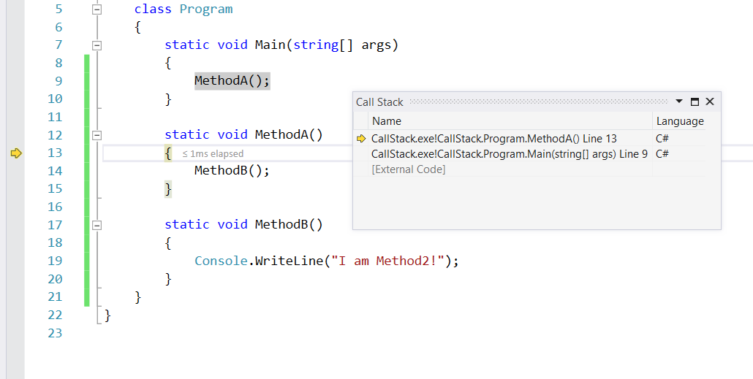
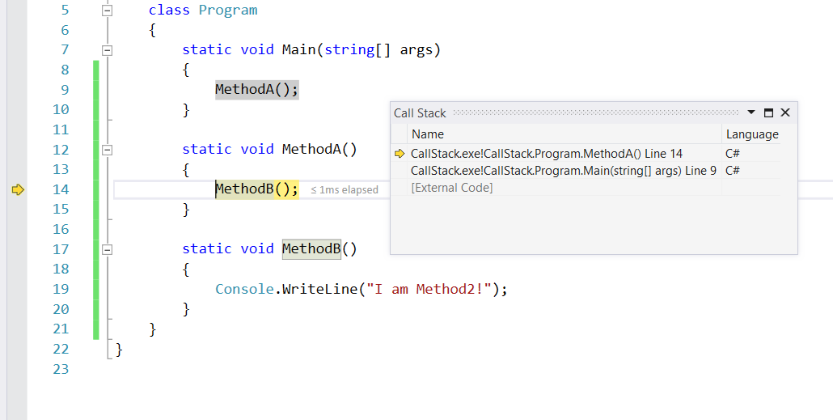
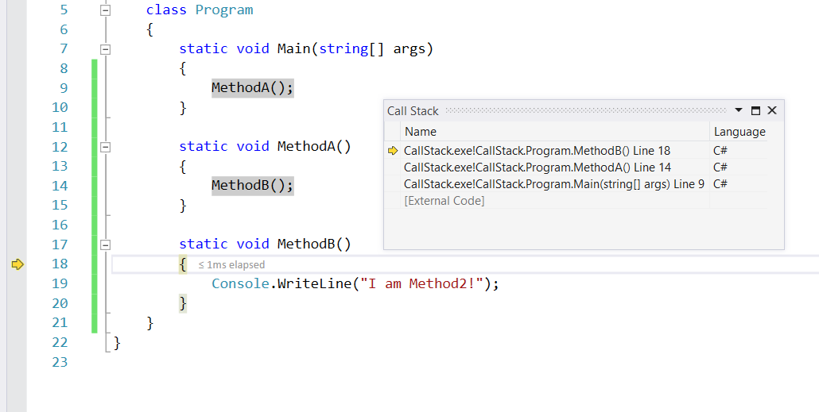
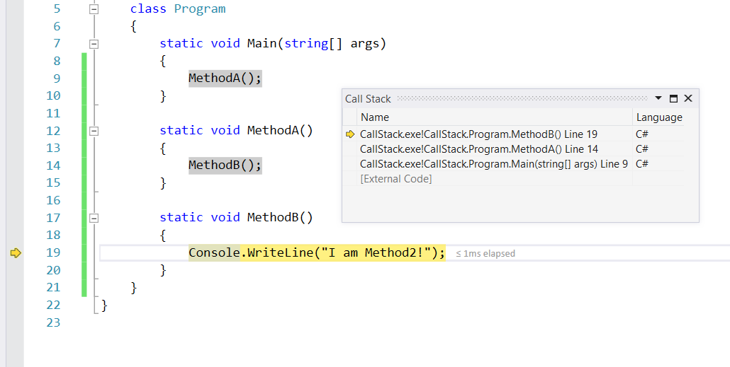
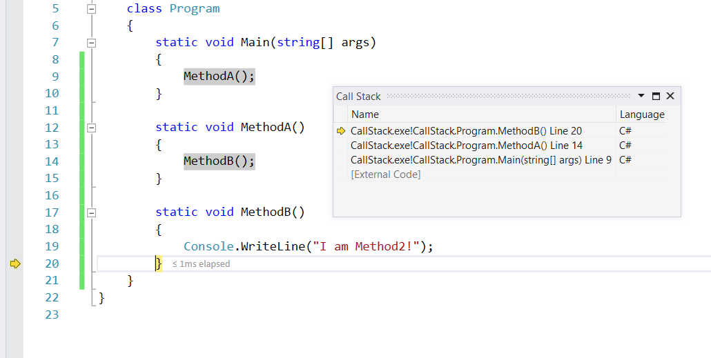
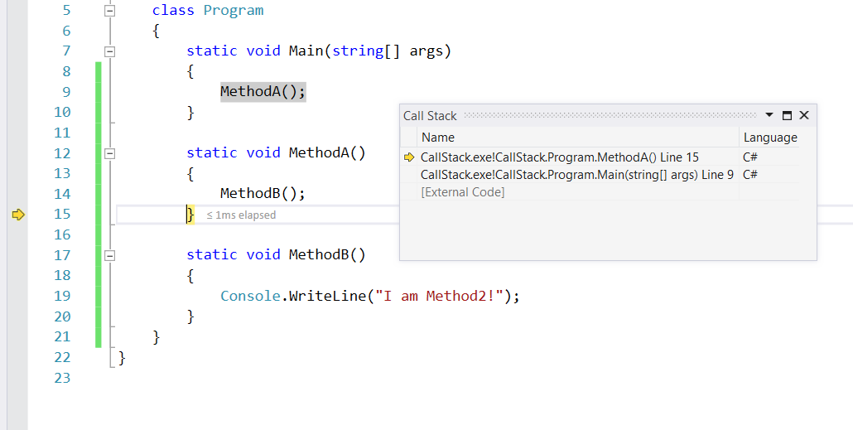
The Execution Stack
Method call
Method call

Slide 8
Problem: Multiply Even by Odd Digits
Create a program that multiplies the sum of all even digits of a number by the sum of all odd digits of the same number:
Create a method called GetMultipleOfEvensAndOdds()
Create a method GetSumOfEvenDigits()
Create GetSumOfOddDigits()
You may need to use Math.Abs() for negative numbers
-12345
Evens: 2 4
Odds: 1 3 5
Even sum: 6
Odd sum: 9
54
Check your solution here: https://judge.softuni.bg/Contests/Practice/Index/419#0

Slide 9
Solution: Multiply Even by Odd Digits
static void Main()
{
// TODO: read input
var evenOddProduct = GetMultipleOfEvensAndOdds(num);
// TODO: print output
}
static int GetMultipleOfEvensAndOdds(int num)
{
var product = GetSumOfOddDigits(num) * GetSumOfEvenDigits(num);
return product;
}

Slide 10
Solution: Multiply Even by Odd Digits (2)
static int GetSumOfEvenDigits(int num)
{
var sum = 0;
while (num > 0)
{
var currentDigit = num % 10;
if (currentDigit % 2 == 0)
sum += currentDigit;
num /= 10;
}
return sum;
}

Slide 11

Debugging
Fixing Bugs in Code

Slide 12
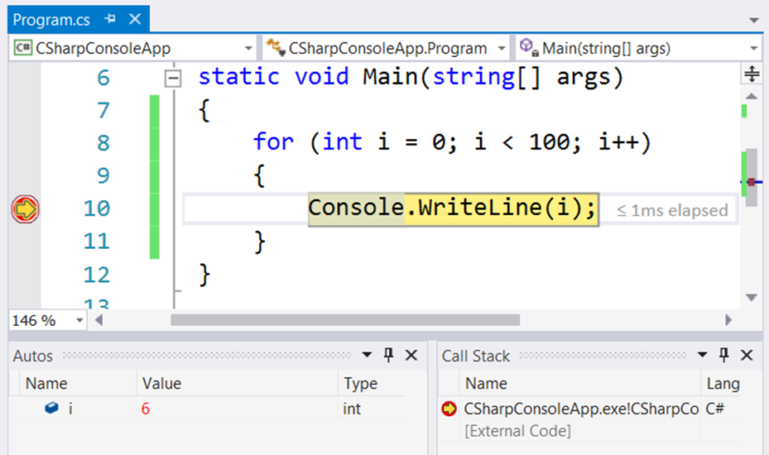

What is Debugging?
The process of locating and fixing bugs (errors) in program code
Debugging tools (called debuggers) help identify coding errors at various development stages

Slide 13

Debugging Process
The Debugging process includes:
Spotting an error
Finding the lines of code that caused the error
Fixing the error in the code
Testing to check if the error is gone and no new errors are introduced
Iterative and continuous process
Debuggers help a lot. Really!

Slide 14
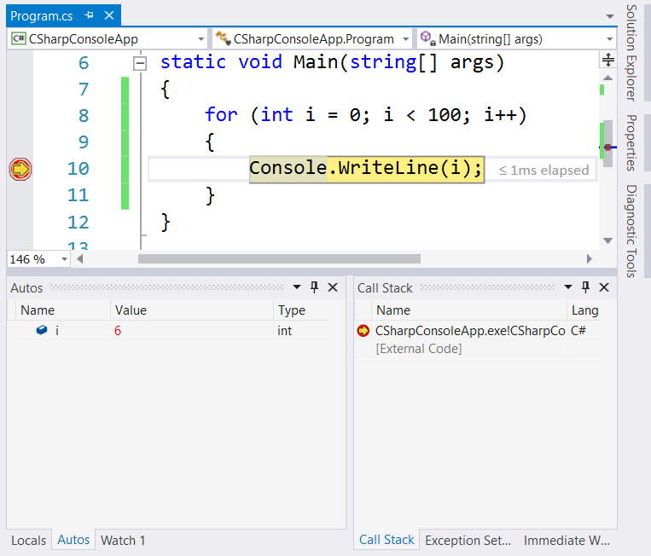
Breakpoints

Slide 15

Breakpoints
Ability to stop execution based on certain criteria is key when debugging
When a function is hit
When data changes
Conditions are true
Visual Studio's debugger has a strong breakpoint feature set

Slide 16
Visual Studio Breakpoints
Stops execution at a specific instruction (line of code)
Can be set by:
Debug->Toggle Breakpoint
[F9] shortcut
Clicking to the left of a line of code
By default, the breakpoint will hit every time execution reaches the line of the code

Slide 17
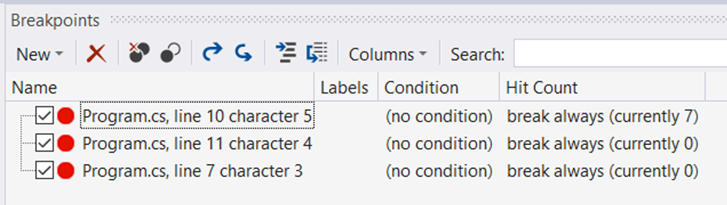
Managing Breakpoints
Configured from the [Breakpoints] window in Visual Studio
Adding breakpoints
Removing or disabling breakpoints
Labeling or grouping breakpoints

Slide 18
Conditional Breakpoints
Stop execution only when the set condition is true
Breakpoint condition

Slide 19
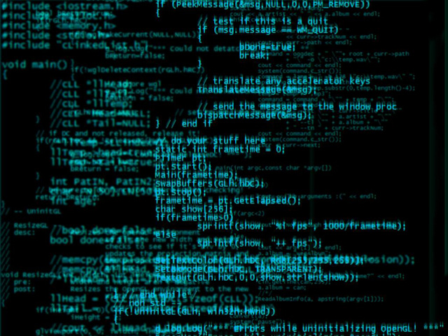

Data Inspection

Slide 20
Data Inspection
Debugging is all about data inspection
What are the local variables?
What is in memory?
What is the code flow?
In general:
What is the state of the process right now?
And how did it get there?
As such, data inspection is key to a quick resolution of problems
data
data
data

Slide 21
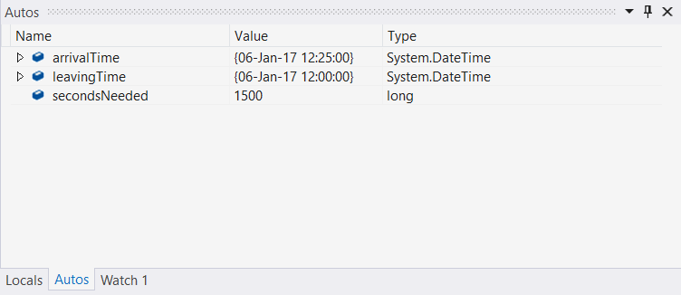
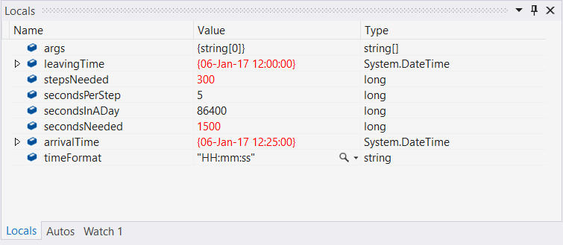
Visual Studio Data Inspection
Visual Studio offers great data inspection features
Watch windows
Autos and Locals
Data Tips
Immediate window

Slide 22
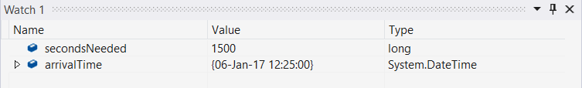
Watch Window
Allows you to inspect various states of your application
Several different kinds of "predefined" watch windows
Autos
Locals
"Custom" watch windows also possible
Contain only variables that you choose to add
Right click on the variable and select [Add to Watch]

Slide 23
Locals
Locals watch window shows the local variables for the specific stack frame
[Debug] -> [Windows] -> [Locals]
Displays: name of the variable, value and type
Allows you to drill down into objects by clicking on the ▷ button in the window

Slide 24
Autos
Autos lets the debugger decide which variables to show in the window
Loosely based on the current and previous statement

Slide 25
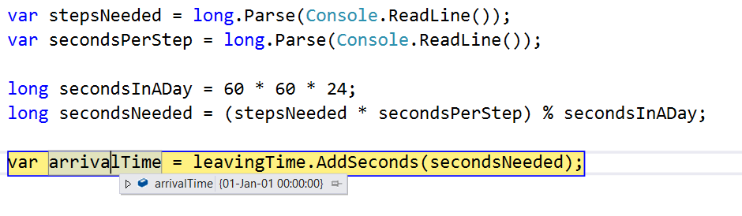
Data Tips
Provide information about variables
Variables must be within scope of current execution
Place mouse pointer over any variable
Variables can be expanded by using the "+" sign
Pinning the data tip causes it to always stay open

Slide 26
Debugging in Visual Studio
Visual Studio has a built-in debugger
It provides:
Breakpoints
Ability to trace the code execution
Ability to inspect variables at runtime

Slide 27
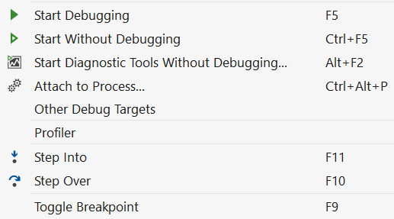
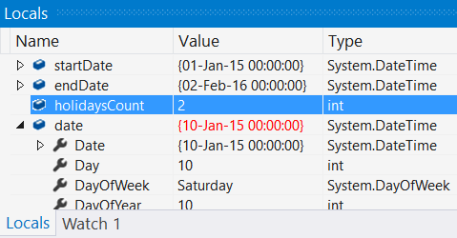
Using the Debugger in Visual Studio
Start without Debugger: [Ctrl+F5]
Toggle a breakpoint: [F9]
Start with the Debugger: [F5]
Trace the program: [F10] / [F11]
Using the Locals / Watches
Conditional breakpoints
Enter debug mode after exception

Slide 28
Problem: Find and Fix the Bugs in the Code
A program aims to count the non-working days between two dates (e.g. 1.05.2016 … 15.05.2016 → 5 non-working days). Debug it!
var startDate = DateTime.ParseExact(Console.ReadLine(),
"dd.m.yyyy", CultureInfo.InvariantCulture);
var endDate = DateTime.ParseExact(Console.ReadLine(),
"dd.m.yyyy", CultureInfo.InvariantCulture);
var holidaysCount = 0;
for (var date = startDate; date <= endDate; date.AddDays(1))
if (date.DayOfWeek == DayOfWeek.Saturday &&
date.DayOfWeek == DayOfWeek.Sunday) holidaysCount++;
Console.WriteLine(holidaysCount);
Check your solution here: https://judge.softuni.bg/Contests/Practice/Index/419#1

Slide 29
Solution: Find and Fix the Bugs in the Code
A program aims to count the non-working days between two dates (e.g. 1.05.2016 … 15.05.2016 → 5 non-working days). Debug it!
var startDate = DateTime.ParseExact(Console.ReadLine(),
"dd.M.yyyy", CultureInfo.InvariantCulture);
var endDate = DateTime.ParseExact(Console.ReadLine(),
"dd.M.yyyy", CultureInfo.InvariantCulture);
var holidaysCount = 0;
for (var date = startDate; date <= endDate; date = date.AddDays(1))
if (date.DayOfWeek == DayOfWeek.Saturday ||
date.DayOfWeek == DayOfWeek.Sunday) holidaysCount++;
Console.WriteLine(holidaysCount);
Check your solution here: https://judge.softuni.bg/Contests/Practice/Index/419#1

Slide 30
Problem: Price Change Alert
A program tracks stock prices and gives updates about the significance in each price change
Download the source code and get familiar with it: Broken Code
Give methods a proper name
Fix method parameters naming
Deal with poor code formatting
Get(c, l)
GetPercentageDifference(currentPrice, lastPrice)
Check your solution here: https://judge.softuni.bg/Contests/Practice/Index/419#2

Slide 31

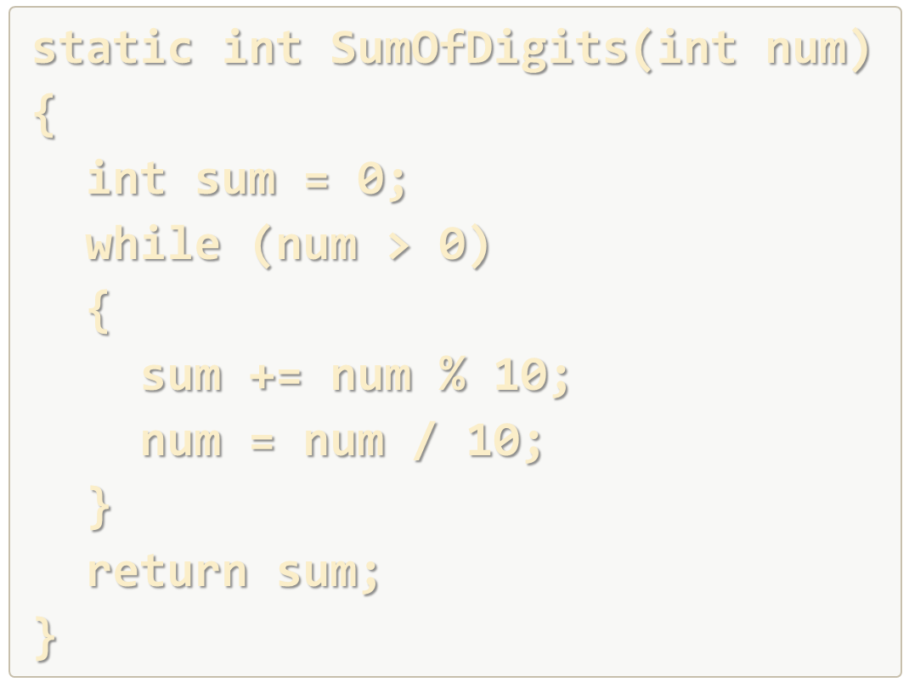
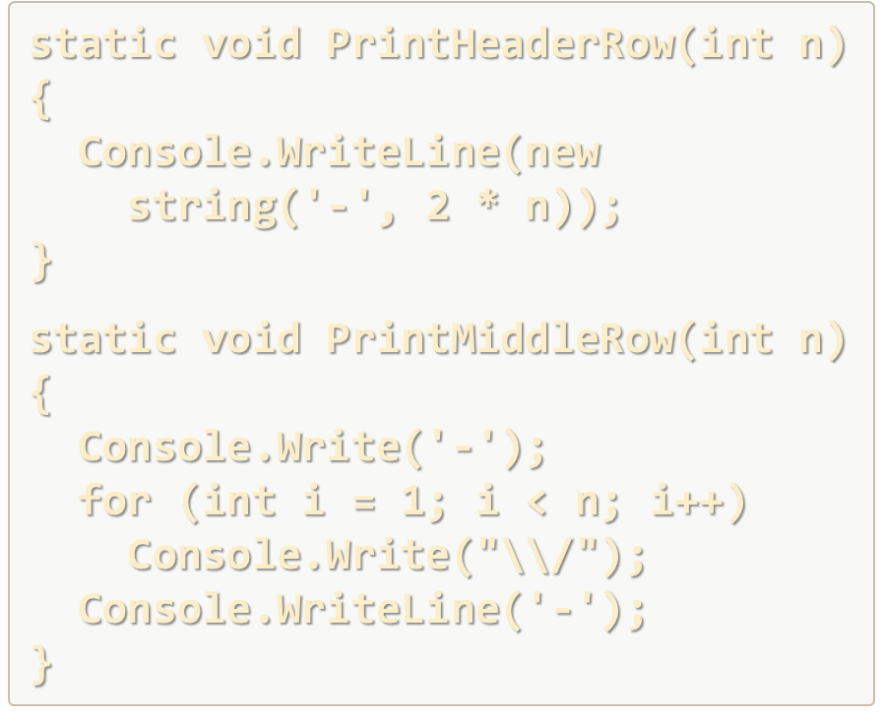
Debugging and Program Flow
Live Exercises in Class (Lab)

Slide 32
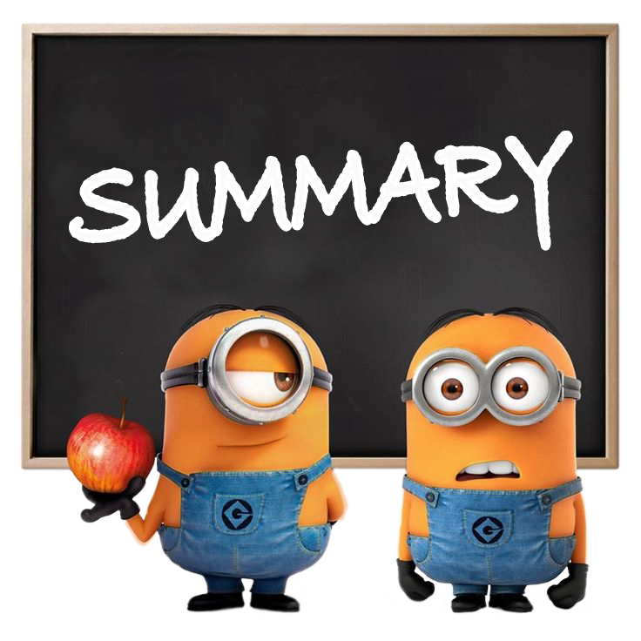
Summary
Debugging helps spotting bugs more easily
Spot, locate, fix, test
Visual Studio has tools for debugging our code
Locals and Autos windows help track variables
Stack view helps view method invocations
Breakpoints let us monitor program behavior
Conditional breakpoints are powerful

Slide 33

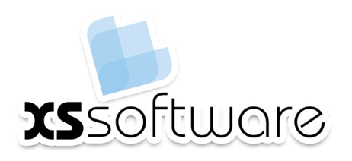






Debugging and Troubleshooting Code
https://softuni.bg/courses/programming-fundamentals

Slide 34

License
This course (slides, examples, demos, videos, homework, etc.) is licensed under the "Creative Commons Attribution-NonCommercial-ShareAlike 4.0 International" license
Attribution: this work may contain portions from
"Fundamentals of Computer Programming with C#" book by Svetlin Nakov & Co. under CC-BY-SA license
Icons from http://www.flaticon.com/ (credits: Freepik, Madebyoliver)

Slide 35






Free Trainings @ Software University
Software University Foundation – softuni.org
Software University – High-Quality Education, Profession and Job for Software Developers
softuni.bg
Software University @ Facebook
facebook.com/SoftwareUniversity
Software University @ YouTube
youtube.com/SoftwareUniversity
Software University Forums – forum.softuni.bg

